Slide 1
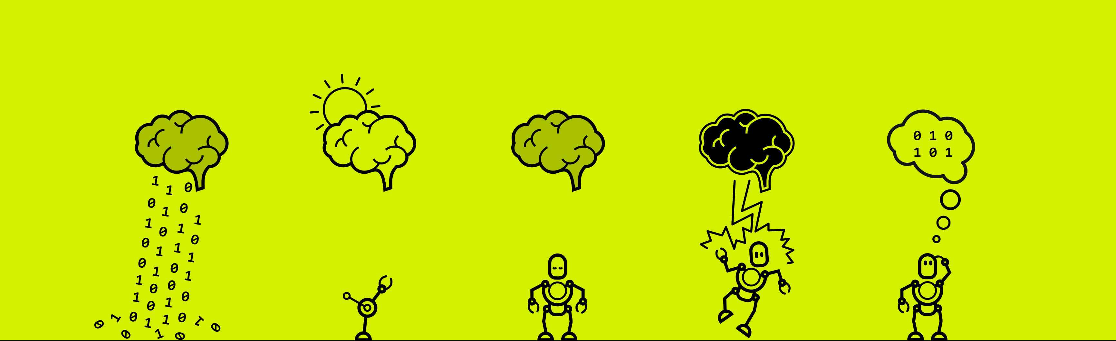


Slide 2

Hand Motion Detection
Rui Jie Li, Claudia Onorato and Josquin Duchaine

Slide 3

INITIAL SITUATION INTRODUCTION…
Goal: Detecting whether the subject is imaging the left hand in motion or at rest

Slide 4
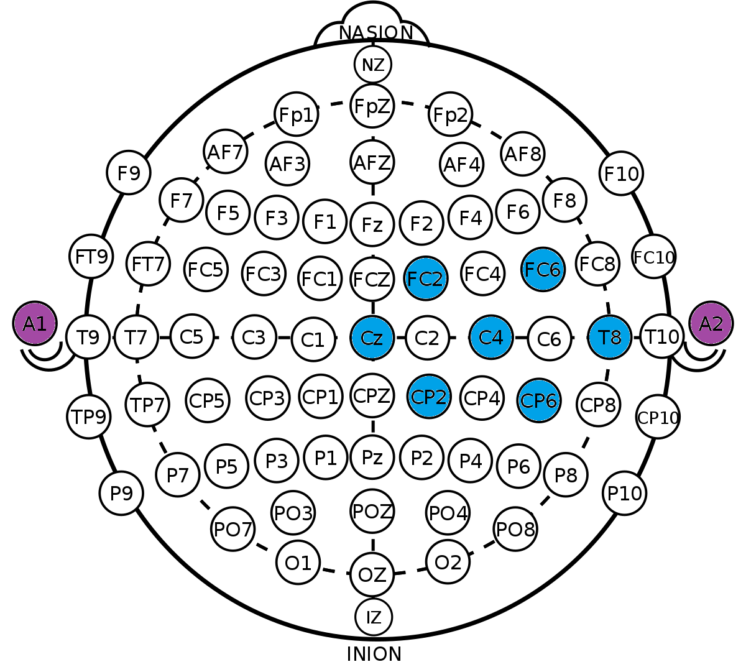
IDEA/SOLUTION…
Training classification models based on certains frequency ranges of electrods placed over the right hemisphere of the motor function area of the cortex.

Slide 5
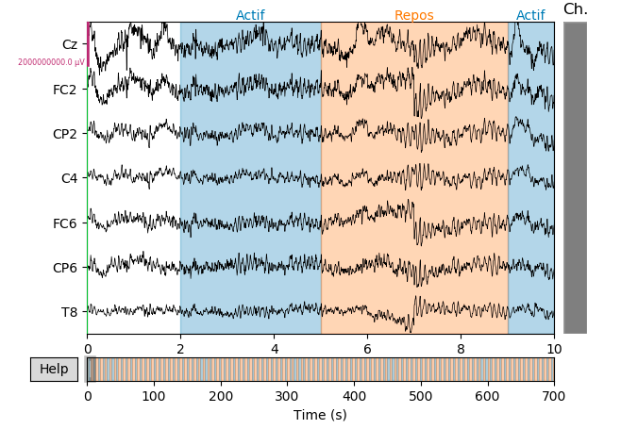
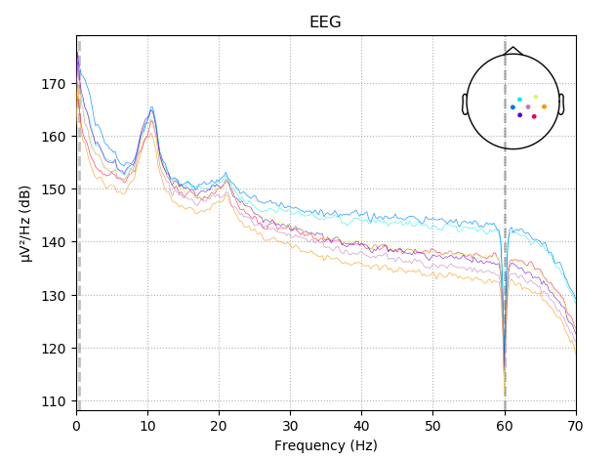
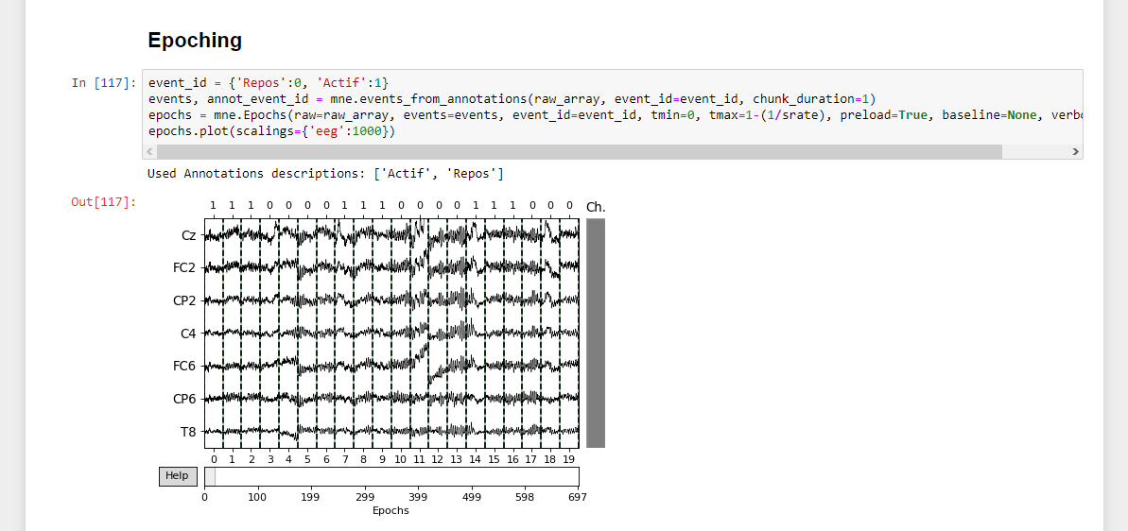
IMPLEMENTATION REALIZATION…

Slide 6
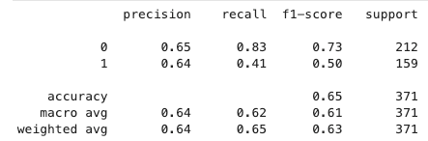
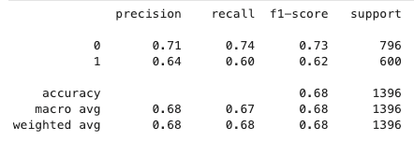
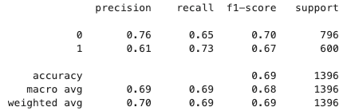
RESULTS OUTCOME…
Random Forest model trained and tested with 2 different homemade datasets with OpenBCI
Random Forest model trained on the s01 to s06 of the GIGADB dataset, GroupShuffleSplit
KNN model trained on the s01 to s06 of the GIGADB dataset, GroupShuffleSplit

Slide 7
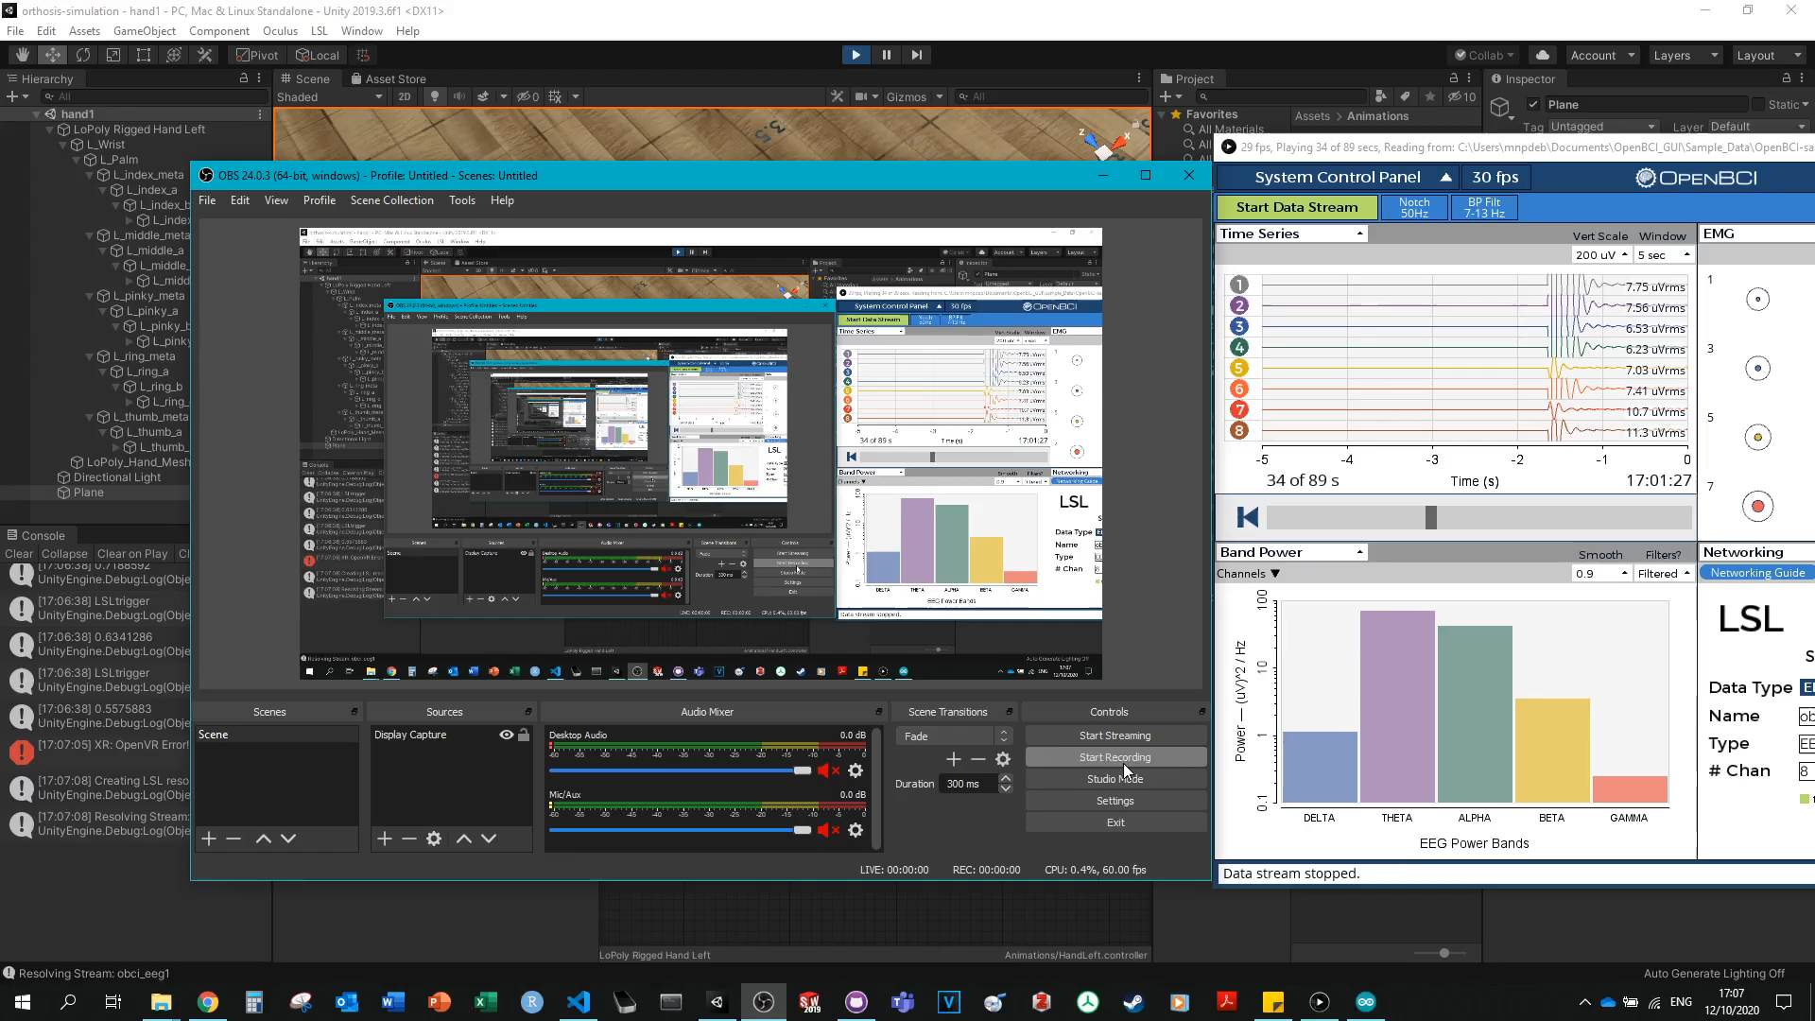

Slide 8
REFLECTION…
With more time we could try different features like CSP
We achieved to build a model with a f1-score better than just random classification
We didn’t try to train any type of Neural Network, could be a possible future improvement

Slide 9
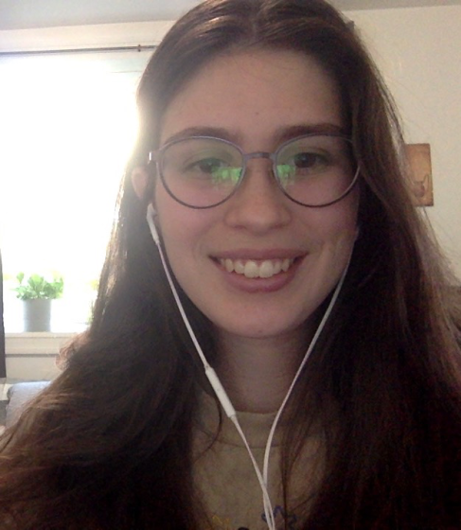
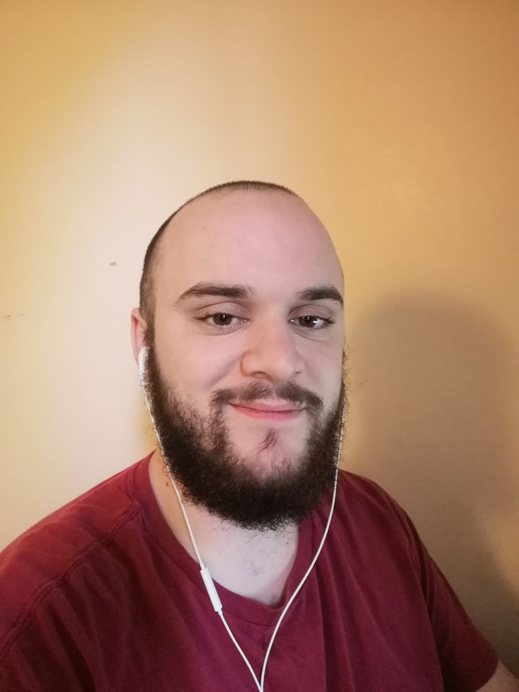
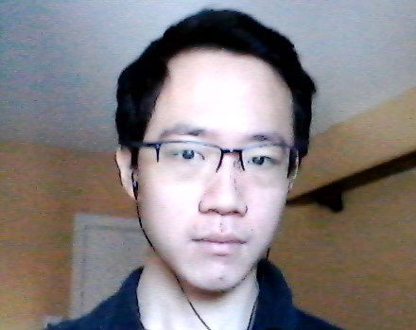
THE TEAM

Slide 10
Hand Motion Detection
Rui Jie Li, Claudia Onorato and Josquin Duchaine

